Slide 1

Fundamentals of Electric Circuits
2020.3
Chapter 3
Methods of Analysis

Slide 2
Chapter3 Methods of Analysis
3.1 Motivation
3.2 Nodal analysis.
3.3 Nodal analysis with voltage sources.
3.4 Loop (Mesh )analysis.
3.5 Loop (Mesh) analysis with current sources.
3.6 Nodal versus mesh analysis.
3.7 Summary

Slide 3
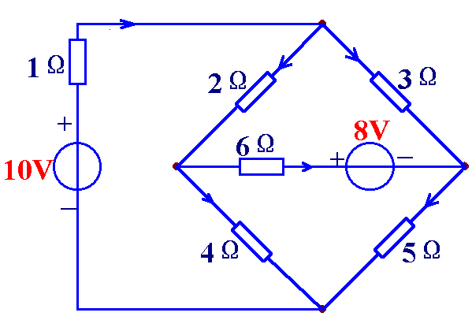
3.1 Motivation
If you are given the following circuit, how can we determine (1) the voltage across each resistor, (2) current through each resistor. (3) power generated by each current source, etc.
i₁
a
+
u₃
₋
+
u₁
-
+
u₂
-
i₃
i₂
i₆
b
c
i₄
+ u₆ -
i₅
+
u₄
₋
+
u₅
₋
d

Slide 4
Things we need to know in solving any resistive circuit with current and voltage sources only:
3.1 Motivation
Kirchhoff’s Current Laws (KCL)
Kirchhoff’s Voltage Laws (KVL)
Ohm’s Law
How should we apply these laws to determine the answers?

Slide 5




i₁
a
Example(n=4,b=6)
+
u₃
₋
+
u₁
-
+
u₂
-
i₃
i₂
i₆
b
c
i₄
+ u₆ -
i₅
+
u₄
₋
+
u₅
₋
KCL
d
a:
b:
n-1 independent KCL equations
c:
n-1 independent nodes, 1 reference node
d:

Slide 6














Example(n=4,b=6)
i₁
+
u₃
₋
+
u₁
-
+
u₂
-
i₃
i₂
KVL
i₆
i₄
+ u₆ -
i₅
+
u₄
₋
+
u₅
₋
b-(n-1) independent KVL equations
Ohm’s law:

Slide 7











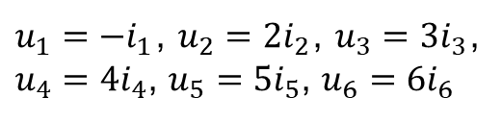

Is it possible to use fewer variables and write fewer equations？
Example(n=4,b=6)
KCL（n-1）
KCL（n-1）
KCL（n-1）
KVL（b-(n-1）)
KVL（b-(n-1）)
KVL（b-(n-1）)
Ohm’s law:
b currents and b voltages
b currents
b voltagess
2b independent equations
b independent equations
b independent equations

Slide 8
In this chapter，we will study two powerful techniques for circuit analysis. These methods are based on the above laws(Kirchhoff’s Laws, Ohm’s Law).
3.1 Motivation (2)
Nodal analysis and Mesh analysis
Please pay attention: Circuit variables, how to write equations

Slide 9
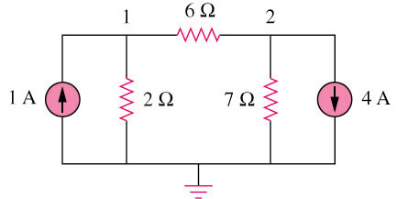
3.2 Nodal Analysis
Circuit variables：node voltages
Equations: KCL for independent nodes, replace current with node voltages
Example 1
3
2 independent nodes, 1 reference node
We can select node 3 as reference node.

Slide 10
3.2 Nodal Analysis (2)
Steps to determine the node voltages:
  Select a node as the reference node.
  Assign voltages v₁,v₂,…,v_{n-1} to the remaining n-1 nodes. The voltages are referenced with respect to the reference node.
  Apply KCL to each of the n-1 non-reference nodes. Use Ohm’s law to express the branch currents in terms of node voltages.
  Solve the resulting simultaneous equations to obtain the unknown node voltages.

Slide 11
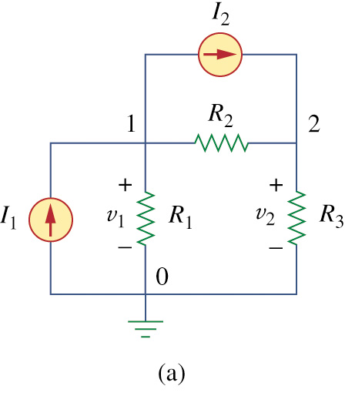
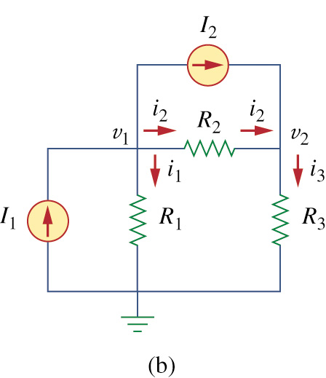
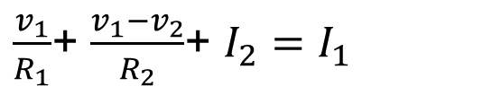
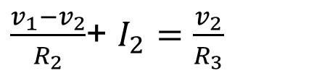
1.Select node 0 as reference node, assigned voltages v₁ and v₂ ,respectively.
2.Applying KCL to node 1 and node 2.
Suppose each resister’s voltage and current are passive sign convention.
At Node 1 and node 2

Slide 12

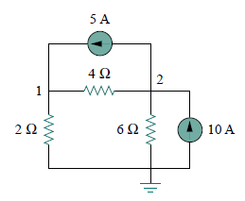



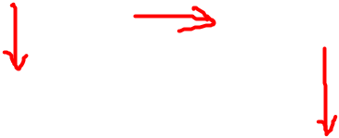

3.2 Nodal Analysis (3)
Example 3 – Calculate the node voltages in the circuit shown in Fig. 3.3(a).
circuit independent current source only
At Node 1
At Node 2
So
Fig. 3.3(a) original circuit.

Slide 13
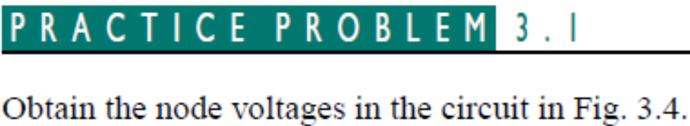
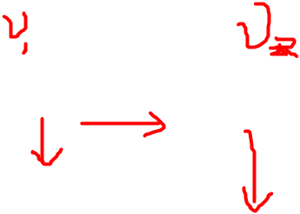
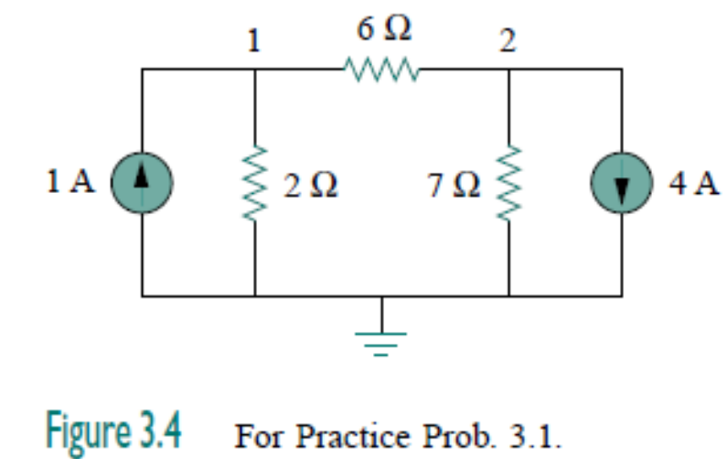

Slide 14
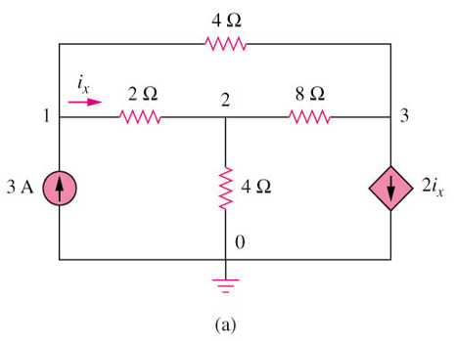







3.2 Nodal Analysis (4)
Example 3 – current with dependant current source
  Write the equation that specifies the relationship of the dependent source to the controlling parameter.

Slide 15
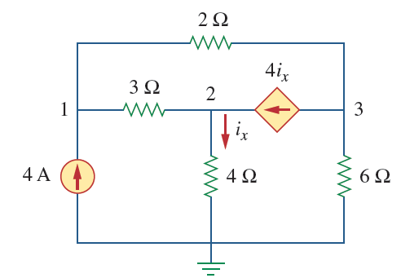
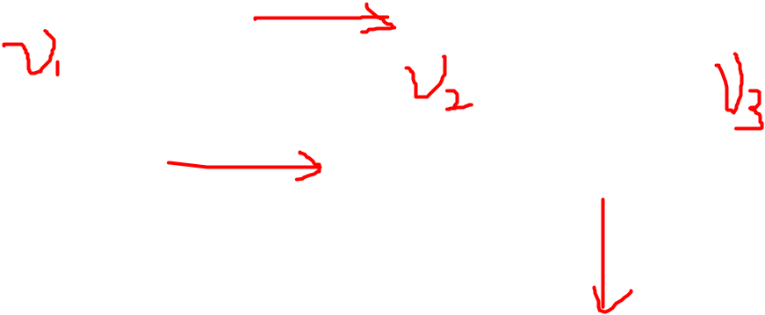


Slide 16

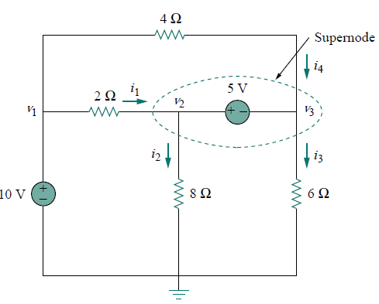


3.3 Nodal Analysis with Voltage Source (1)
If a voltage source is connected between the reference node and a nonreference node, we simply set the voltage at the nonreference node equal to the voltage of the voltage source.
Thus our analysis is somewhat simplified by this knowledge of the voltage at this node.

Slide 17
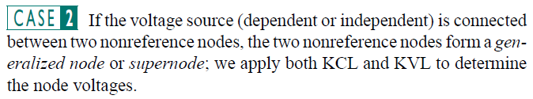
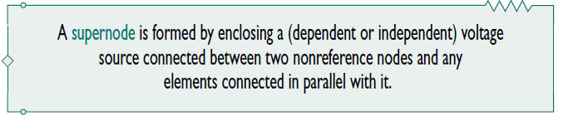
  (1) Apply KCL to super-nodes;
  (2) Write the equation that defines the voltage relationship between the two nonreference nodes as a result of the presences of the voltage source.

Slide 18
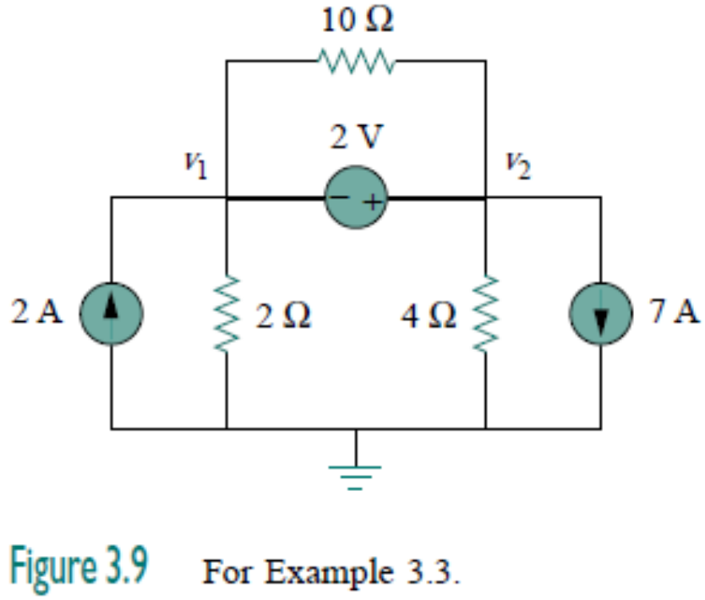
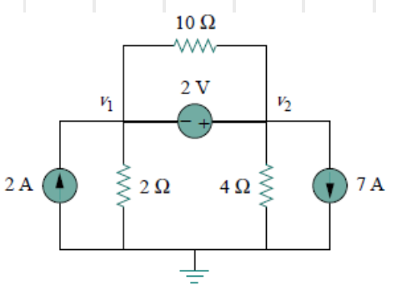

3.3 Nodal Analysis with Voltage Source (2)
Example 5 – For the circuit shown in Fig. 3.9, find the node voltages
v₂ -v₁= 2

Slide 19
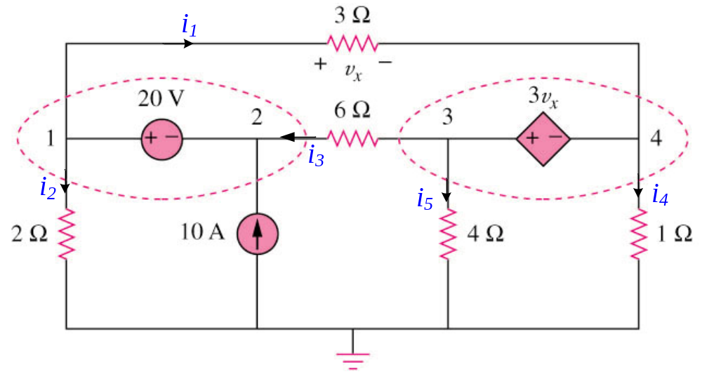


3.3 Nodal Analysis with Voltage Source (4)
Example 7 – circuit with one independent voltage source and one dependent voltage source
supernode 1
supernode 2
Supernode1,
Supernode2,
v₁-v₂ = 20
v₃ - v₄ = 3v_{x}
v₁ - v₄ = v_{x}

Slide 20
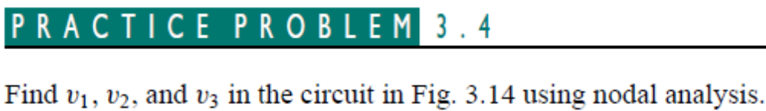
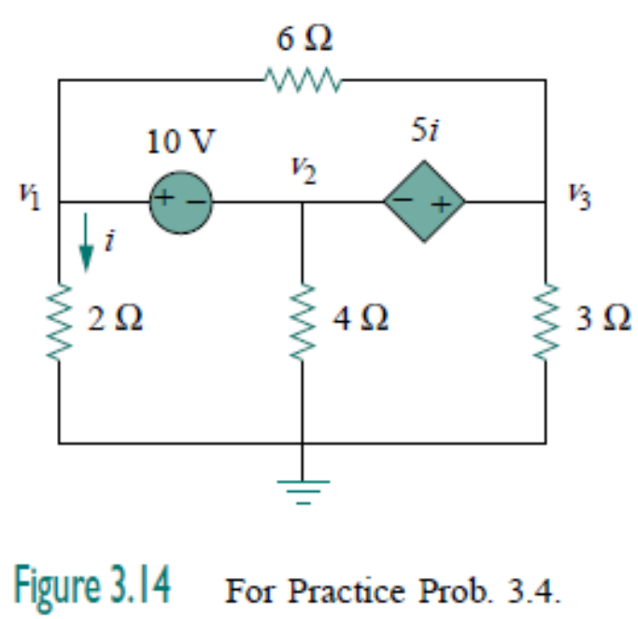

Slide 21
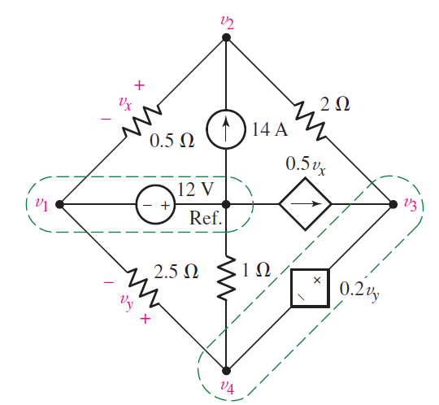










Slide 22

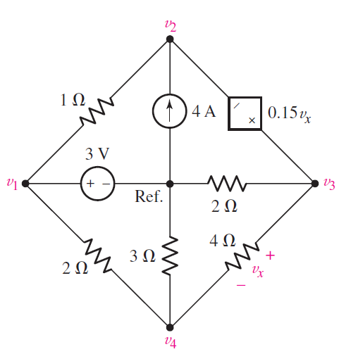

Slide 23
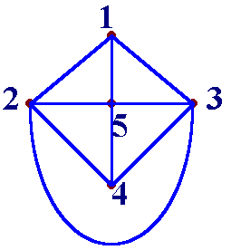
3.4 Mesh Analysis
Planar network: If it is possible to draw the diagram of a circuit on a plane surface in such a way that no branch passes over or under any other branch, then that circuit is said to be a planar circuit.
planar circuit
nonplanar circuit

Slide 24
1.Mesh
A mesh is a loop which does not contain any other loops within it.
2.Mesh current
We define a mesh current as a current that flows only around the perimeter of a mesh.
Circuit variables：
Mesh current
Equations: KVL for meshes, replace voltage with Mesh current
i₄
i₂
i₁
I_{b}
i₆
I_{a}
i₅
i₃
I_{c}
  We should notice that the mesh current is imaginative, not measurable directly.

